Slide 1
Plant Cells

Slide 2
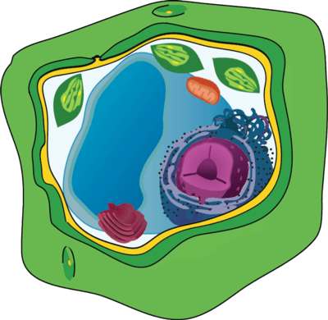
In this Smart Lesson, you will be doing the following:
1. | Identifying the organelles in plant cells.
2. | Comparing plant and animal cells.
3. | Recalling the process of cellular respiration and explaining why it is important for both plant and animal cells.

Slide 3
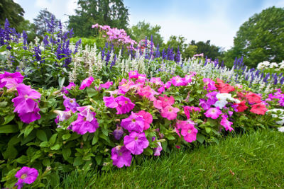
Just like animals are made up of animal cells, plants are made up of plant cells.
Plants belong to the kingdom Plantae, and they are all multicellular. They have specialised cells that do different jobs; for example, leaves are made up of leaf cells, roots are made up of root cells, and petals are made up of petal cells.

Slide 4

Although the plant cells are specialised to their function, they all have the same basic structure with the same types of organelles.
This is what makes them plant cells!

Slide 5
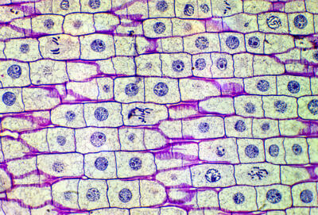
All plant cells have the same basic structure, with the same organelles.
Like animal cells, plant cells are eukaryotic, so they contain a nucleus and other membrane-bound organelles.

Slide 6
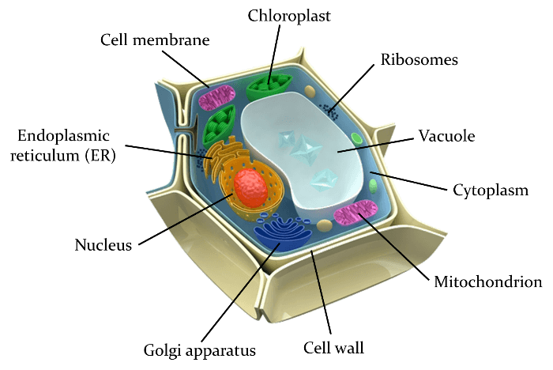
Plant cells have all the same organelles as animal cells, plus some extras.
Here is a diagram of a general plant cell, showing the organelles:

Slide 7
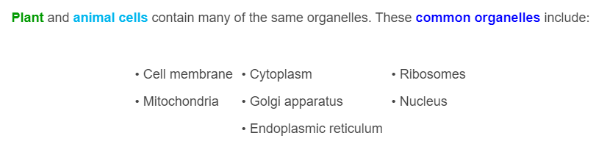
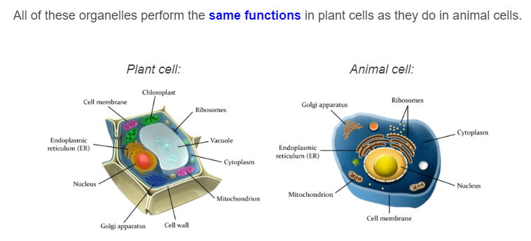

Slide 8
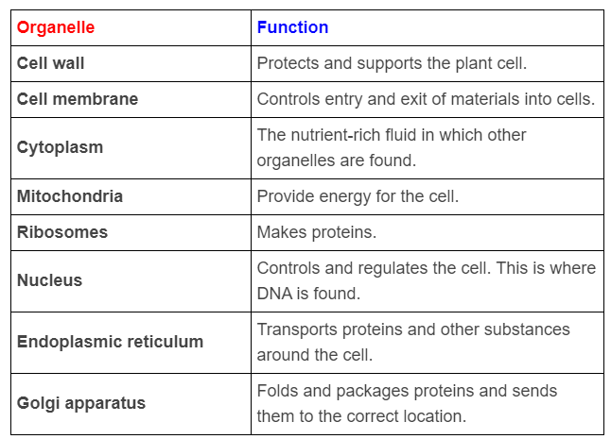
Here's a reminder of what these organelles do:

Slide 9
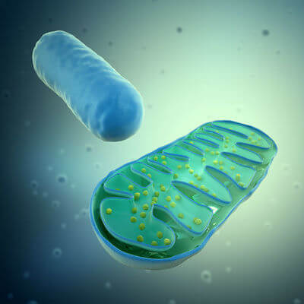
An important thing to understand is that mitochondria produce energy for the cell in a process called cellular respiration. In this process, glucose (sugar) reacts with oxygen, releasing energy.
This energy is in the form of a molecule called ATP.

Slide 10
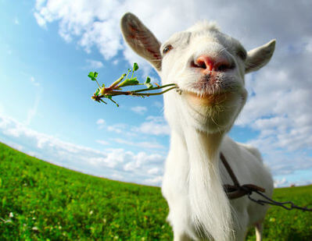
Both plant and animal cells have mitochondria because they both need ATP energy to carry out cellular processes.
The important difference is where the cells get glucose from for the cellular respiration reaction.
Animals must eat food to obtain glucose for their cells to use. Plants create their own glucose in a process called photosynthesis.

Slide 11
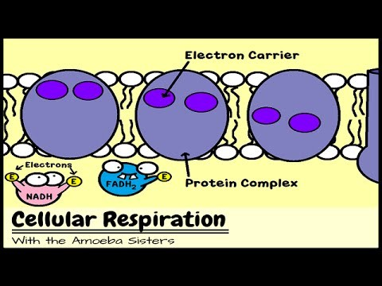

Slide 12
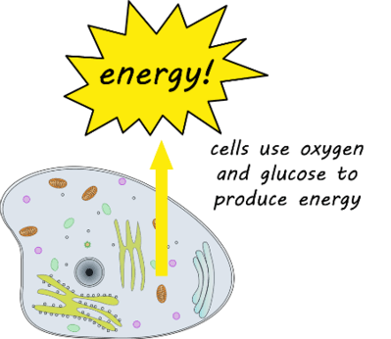
Remember: plant cells have all the same organelles as animal cells (plus a few extras).
Both animal and plant cells have mitochondria. Mitochondria carry out cellular respiration, a process that takes glucose and breaks it down to produce ATP energy that the cell can use for other processes.

Slide 13
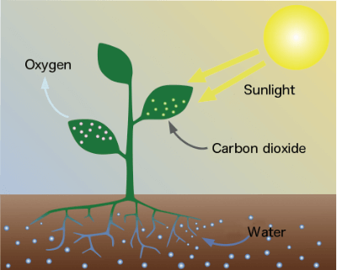
Unlike animal cells, plants actually make their own food!
Plants use a process called photosynthesis to turn sunlight, water and carbon dioxide into glucose (a type of sugar) and oxygen.
Photo means light and synthesis means combining substances to form something new.

Slide 14
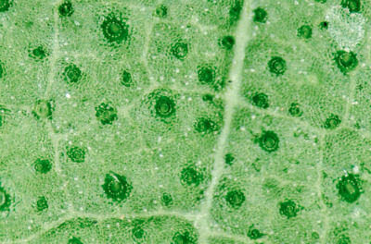
This is a major functional difference between animal and plant cells, and it means that there must be some differences in the structure of animal and plant cells.
Remember, plant cells have all the organelles that animal cells have, plus a few extras.

Slide 15
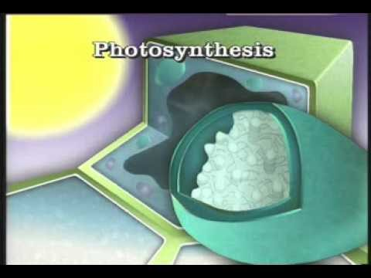

Slide 16
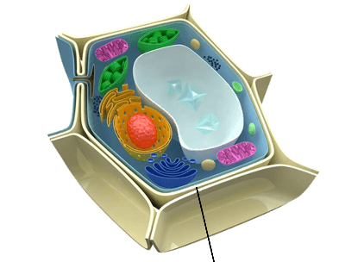
All plant cells have a cell wall.
This is a layer around the outside of the cell that is made of a tough substance called cellulose. The cell wall gives the cell protection and structural support (helping it to hold its shape).
Water and other dissolved substances can move through small pores in the cell wall.
Here is where the cell wall is located in a generalised plant cell diagram:

Slide 17
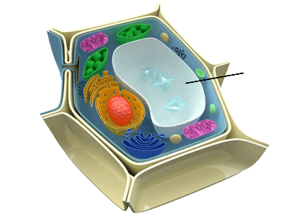
All plant cells have a large vacuole.
This is a membrane-bound sac that stores water, nutrients and sometimes waste products. Fluid in the vacuole helps put pressure on the cell wall and maintains the rigid structure of the cell. The vacuole takes up a majority of the space in a plant cell.
Here is where the vacuole is located in a generalised plant cell diagram:

Slide 18
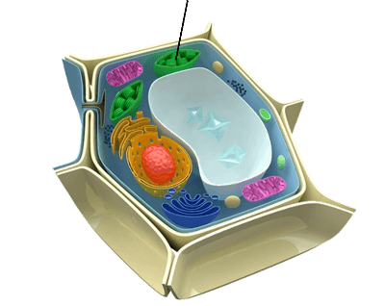
Plant cells in the leaves and stems of the plant have chloroplasts.
Chloroplasts are membrane-bound organelles that carry out the process of photosynthesis. Inside chloroplasts is a compound called chlorophyll, which absorbs all wavelengths of light except green. This is what makes plants appear green!
Here is where a chloroplast is located in a generalised plant cell diagram

Slide 19
Photosynthesis is the process of using the energy from sunlight to turn water and carbon dioxide into glucose and oxygen. This occurs in the chloroplasts.
Mitochondria then take the glucose and break it down in cellular respiration to carbon dioxide, water and ATP energy, which can be used by the cell.

Slide 20
